Slide 1
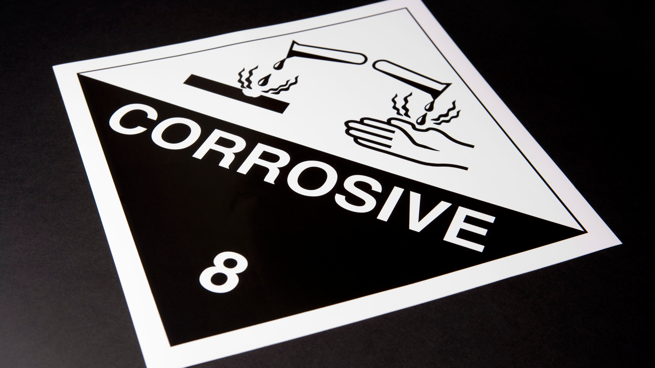
Acids and Bases
ATAR Chemistry Unit 3 2021

Slide 2
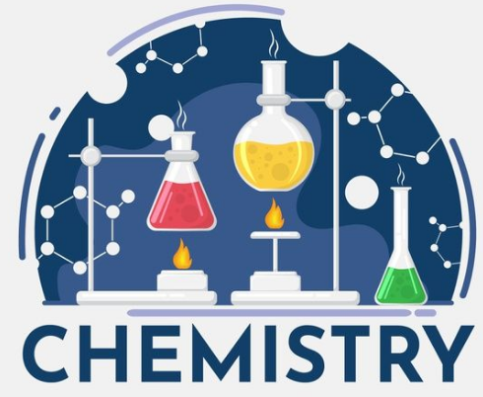
Outline
Summary – Arrhenius and Bronsted-Lowry theories of acids and bases
Amphoteric substances
Arrhenius theory – strength of acids and bases
Bronsted-Lowry – strength of acids and bases
Acid Ionisation constant, Ka

Slide 3
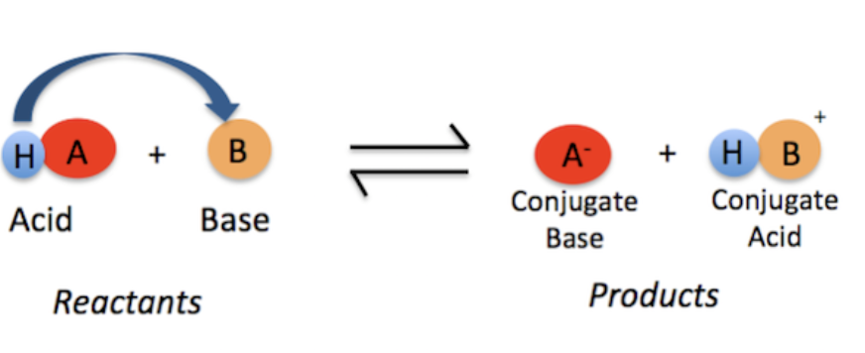
Summary
Arrhenius Theory
Brønsted-Lowry Theory
Acids ionize in water to produce H⁺ ions
Acid is a Proton Donor
Base is Proton Acceptor
Bases dissociates in water to produce OH⁻ ions
The Arrhenius Theory could also account for the strength of Acids based on the extent of the Ionisation reaction (reversible).

Slide 4
Amphoteric substances
Water can act as an acid:
NH₃(g) + H₂O(l) → NH₄⁺(aq) + OH⁻(aq)
And also as a base:
HCl(g) + H₂O(l) → H₃O⁺(aq) + Cl⁻(aq)
Substances that can act as both an acid and a base are called AMPHOTERIC

Slide 5
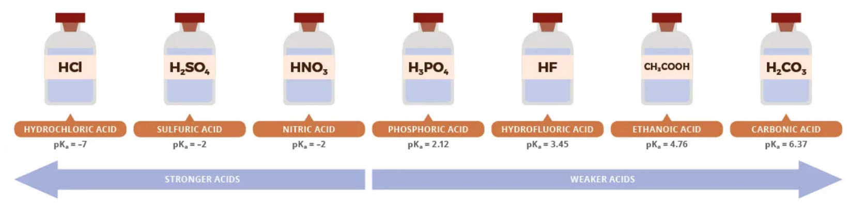
Strength of acids and bases

Slide 6
Strength of acids and bases
Strong Acids
Weak Acids
According to Arrhenius theory, when strong acids are dissolved all of the acid breaks up into hydrogen ions and negative ions.
According to Arrhenius theory, when weak acids are dissolved most of the acid remains as the molecule and only a small amount breaks up into hydrogen ions and negative ions
HCl_{(g)} → H⁺_{(aq)} + Cl⁻_{(aq)}
CH₃COOH_{(aq)} CH₃COO⁻_{(aq)} + H⁺_{(aq)}
0 %
100 %
99 %
1 %

Slide 7
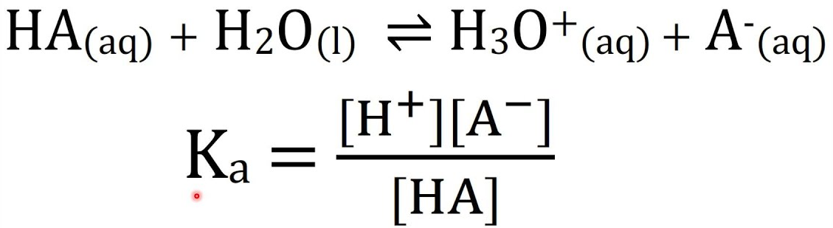
Strength of acids and bases
Bronsted-Lowry Acids
The equation for an acid ionisation can bee looked at using equilibrium principles. In doing so the strength of acids can be quantified.
The Acid ionisation constant (Ka) is an equilibrium constant (usually measured at 25ºC) and can be used to identify the extent of ionisation (ie strength)

Slide 8
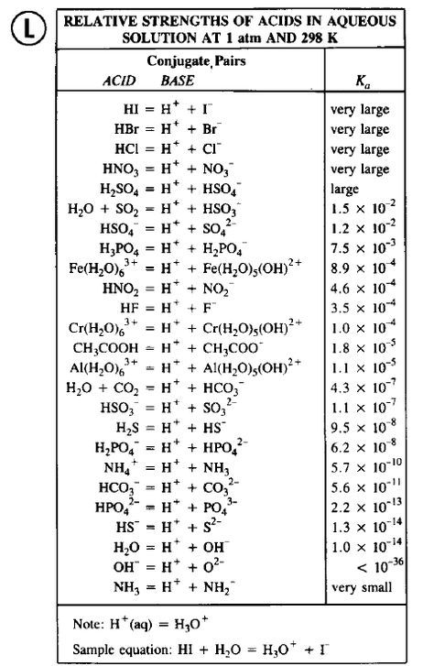
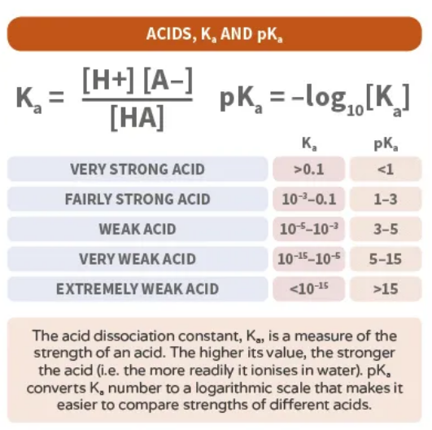
Strength of acids and bases

Slide 9
Strength of acids and bases
Some important points
The H₃0⁺ is the strongest acid that can exist in water. Acids stronger that H₃O⁺ will react with water to completely ionise in solution and not exist in molecular form in solution.
Eg HCl (g) + H₂O (l) → H₃O⁺ (aq) + Cl⁻ (aq)
The OH⁻ is the strongest base that can exist in water. Bases stronger than OH⁻ (such as oxide or amide) will react with water to produce OH⁻ and their conjugate acids.
Eg NH₂⁻ (aq) + H₂O (l) → NH₃ (aq) + OH⁻ (aq)

Slide 10
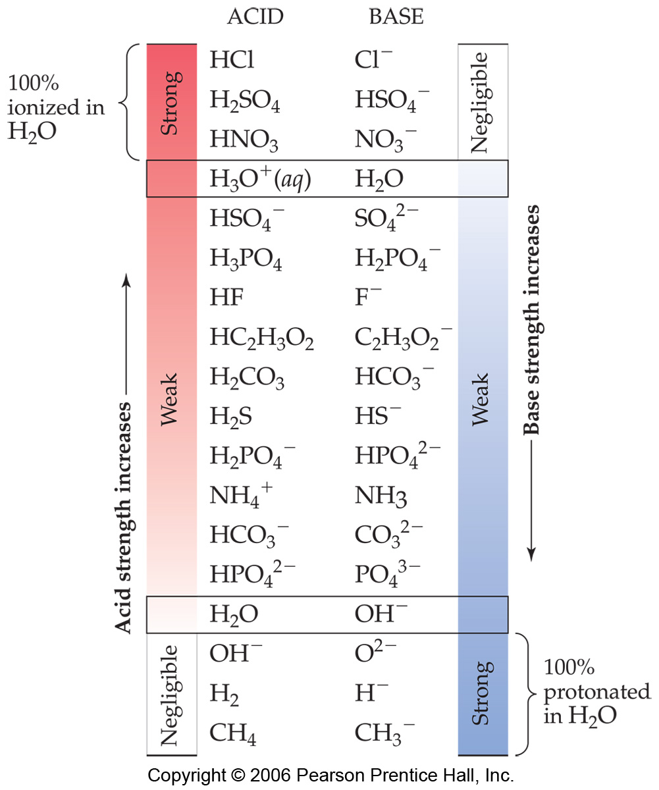
Strength of acids and bases
Strong acids are completely ionised in water (100%)
Their conjugate bases are extremely weak.
Weak acids are only partially ionised
Their conjugate bases are stronger
The weaker the acid, the stronger the conjugate base.

Slide 11
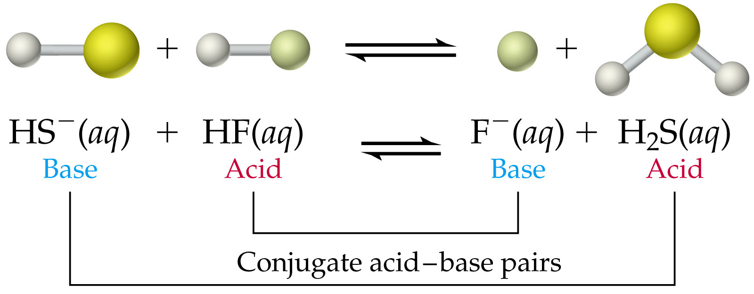
Strength of acids and bases
Using the acid ionisation constants (Ka) the equilibrium position of a reaction between an acid and base can be predicted.
A stronger acid and base will react to produce a weaker acid and base.
Example:
HF is a stronger acid than H₂S, hence HS⁻ is a stronger base that F⁻ and this would drive the equilibrium to the right and favour the products.

Slide 12
Polyprotic
Acids like HCl, HNO₃ and CH₃COOH are referred to as monoprotic acids as they produce one proton when they ionise or dissociate.
Some acids produce more than one proton…
Sulfuric acid is a diprotic acid. It is a strong acid so completely loses its first proton:
H₂SO₄ + H₂O → H₃O⁺ + HSO₄⁻
The hydrogensulphate ion formed above then acts as a weak acid resulting in the loss of the second proton:
HSO₄⁻ + H₂O H₃O⁺ + SO₄²⁻

Slide 13
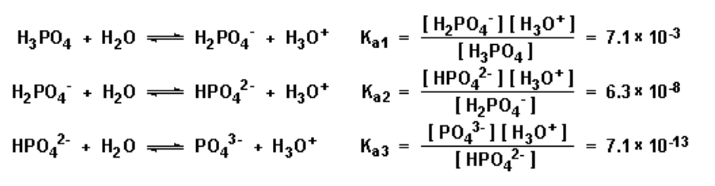
Polyprotic
A polyprotic acid can successively donate protons.
This is because the conjugate base can also act as an acid (called amphiprotic)
For a polyprotic acid, each subsequent acid ionisation constant decreases for each proton donation.
Most
Less
Least

Slide 14
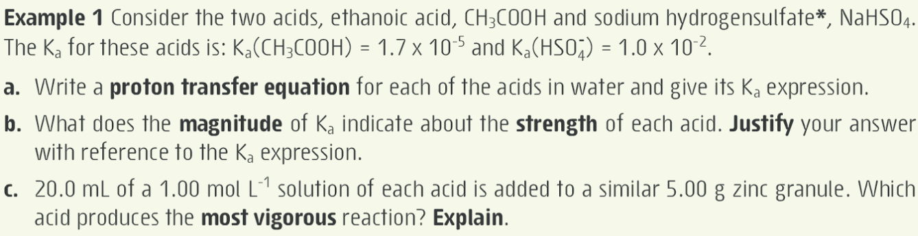
Exercise

Slide 15
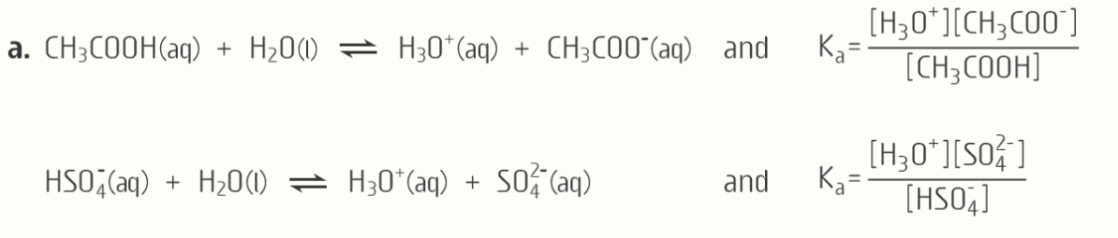
Exercise

Slide 16
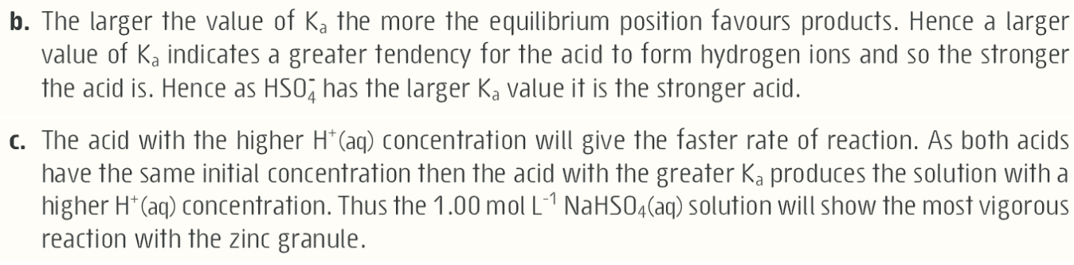
Exercise

Slide 17
On-going work
Essential chemistry ch 4.1-4.5, Set 4 Q 1 – 15
Review of the reactions of acids and bases
Essential chemistry ch 3, Set 3 all questions

